Slide 1
reference report

Slide 2
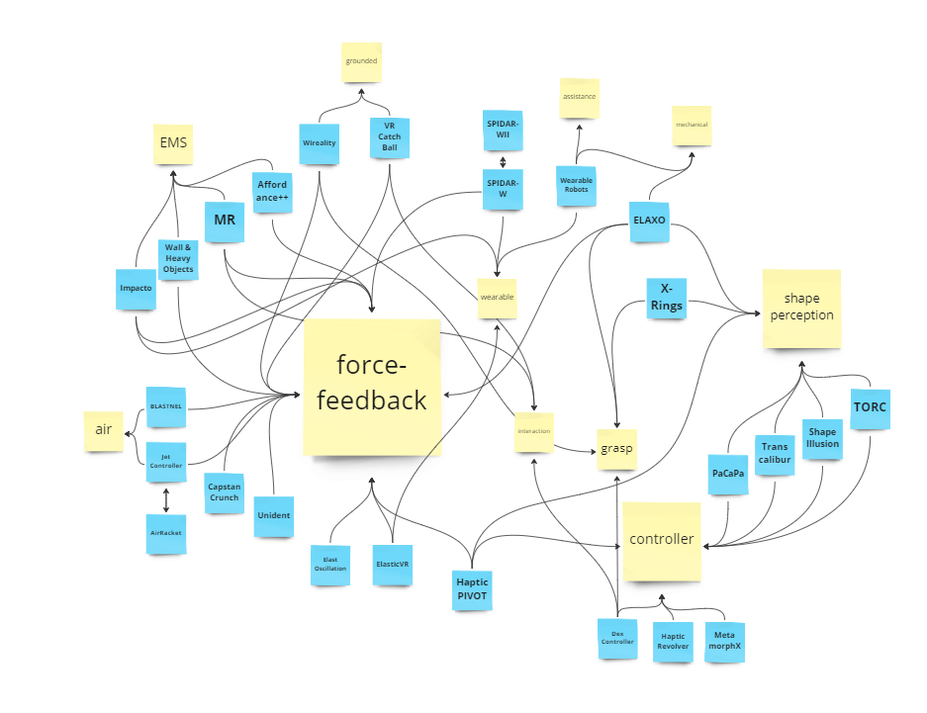
catalog by keywords
criteria：
keyword
abstract & introduction
compared to others
*Not classified to the category when it is not mentioned the concept.

Slide 3
study case

Slide 4
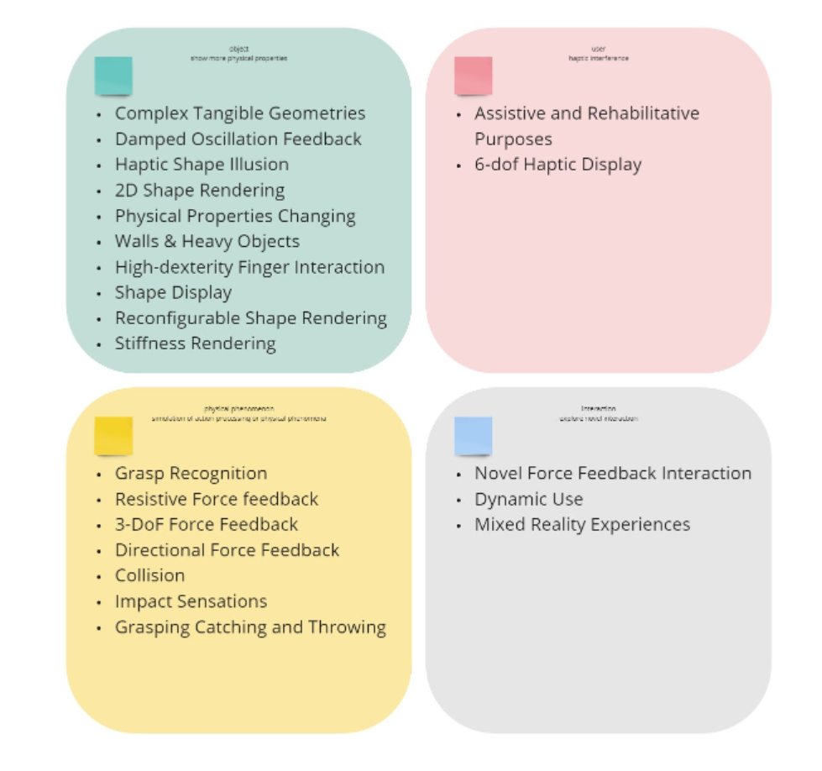
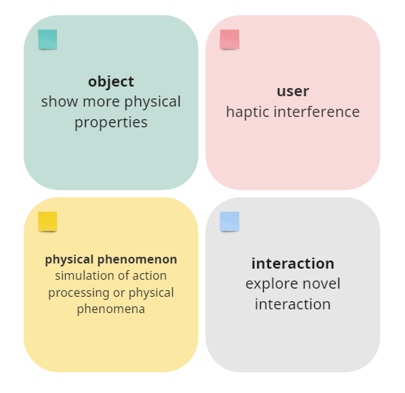
catalog by research object

Slide 5
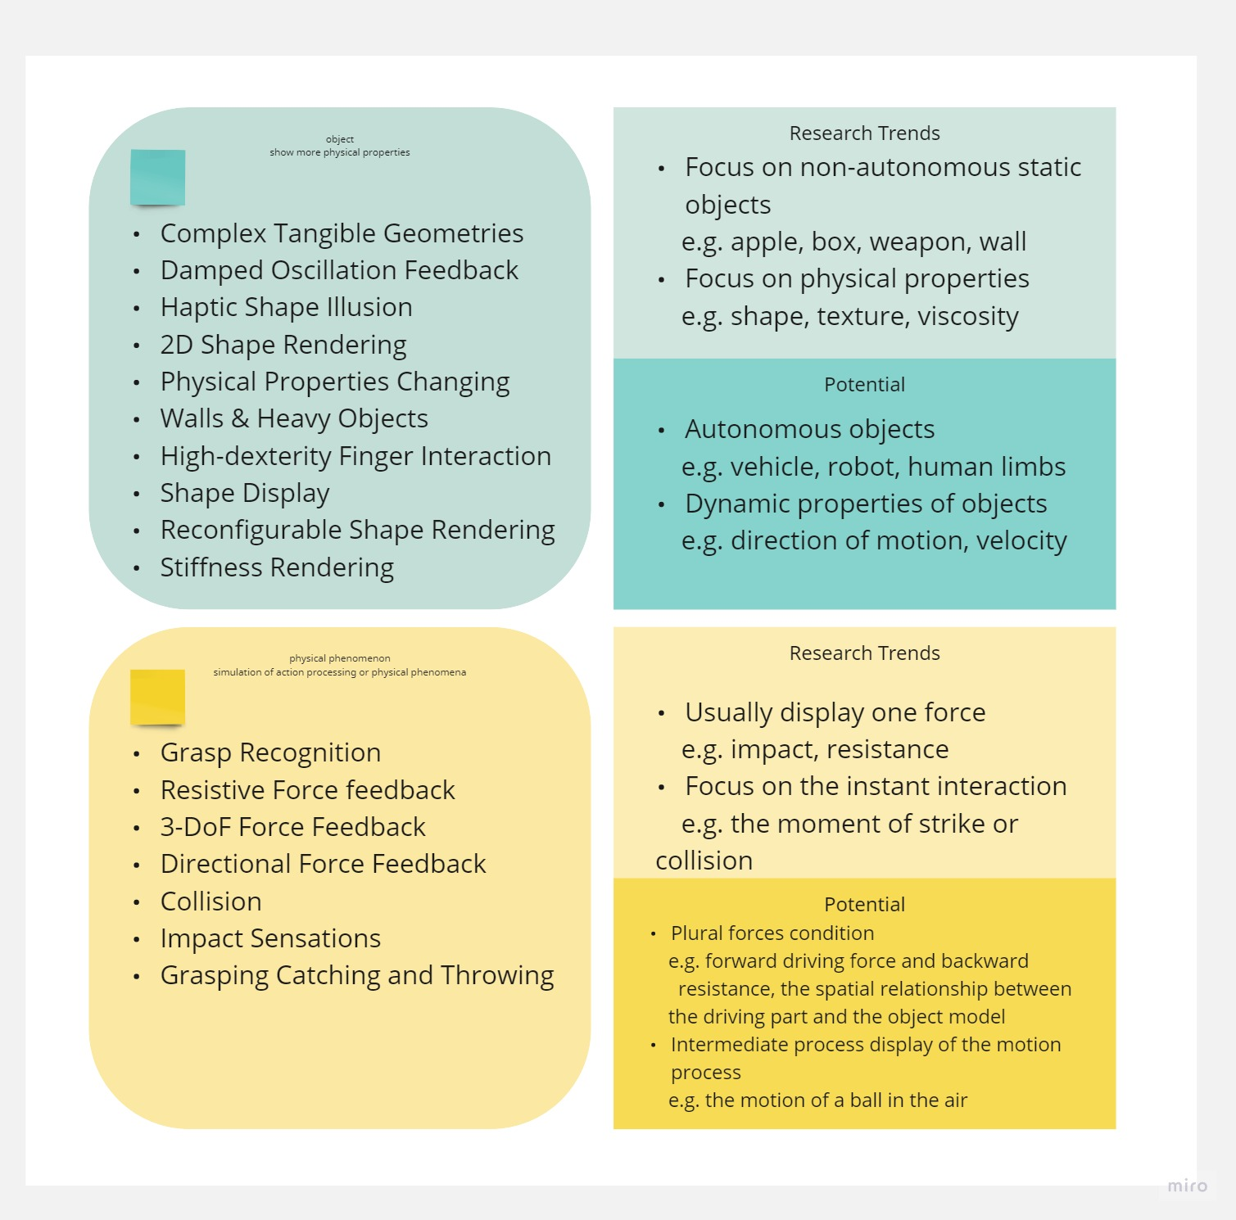
research trends

Slide 6
motion state
no specific definition of motion
avatar target：limb movement, sports movement, actio haptic
object target：motion state, movement haptic
synonym：movement, action, sports,motion state, 6 dof haptic display
potential functions: displacement,navigation,locamotion

Slide 7
abstract report

Slide 8
A continuous motion feedback controller
A controller that can continuously feedback the motion state of dynamic objects under VR environment
Notes:
motion state help user manipulate

Slide 9
research question
Inconsistency of vistual feedback and real hand motion.
--A Survey on Simulation for Weight Perception in Virtual Reality
How to show the movement/motion state by haptic?
Why? Because objects in VR space are constrained by the map design and the physics engine, but the user has no any reference or limitations in the VR activity area of reality.

Slide 10
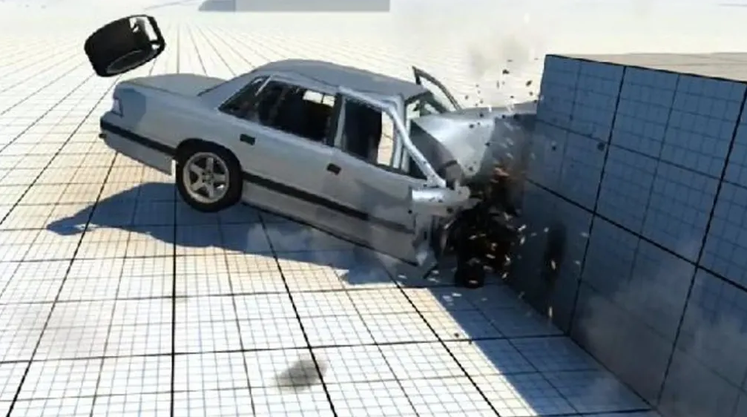
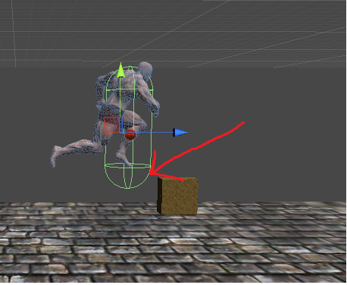
example
For example, when the avatar encounters an obstacle, the current VR visual only can show the character is unable to move forward, and according to most studies will only have resistance force or vibration to provide interaction. But the ideal effect is that the user should feel the forward force of the character and the resistance of the obstacle, more specifically, the driving force of the legs and the resistance from the touch point.

Slide 11
purpose
This project is designed to reveal the motion state of the object or avatar under the VR environment, and give feedback to the user, in order to enhance the user's ability to manipulate the object so that the user is more aware of the interaction with the currently manipulated thing.
The motion state is the overall motion state of the object, and is not limited to a single force situation, or it can also represent the motion state of a small part.
Through such motion state feedback, aim to enhance the user's operation under the VR environment, can help user understand the current object's motion state, enhance the synchronization rate and connection between the user and the manipulated object, enhance the VR immersion. Can also be applied with telexistence. Make the robot easier to operate, and help operater quickly understand the movement state of various parts of the robot.

Slide 12
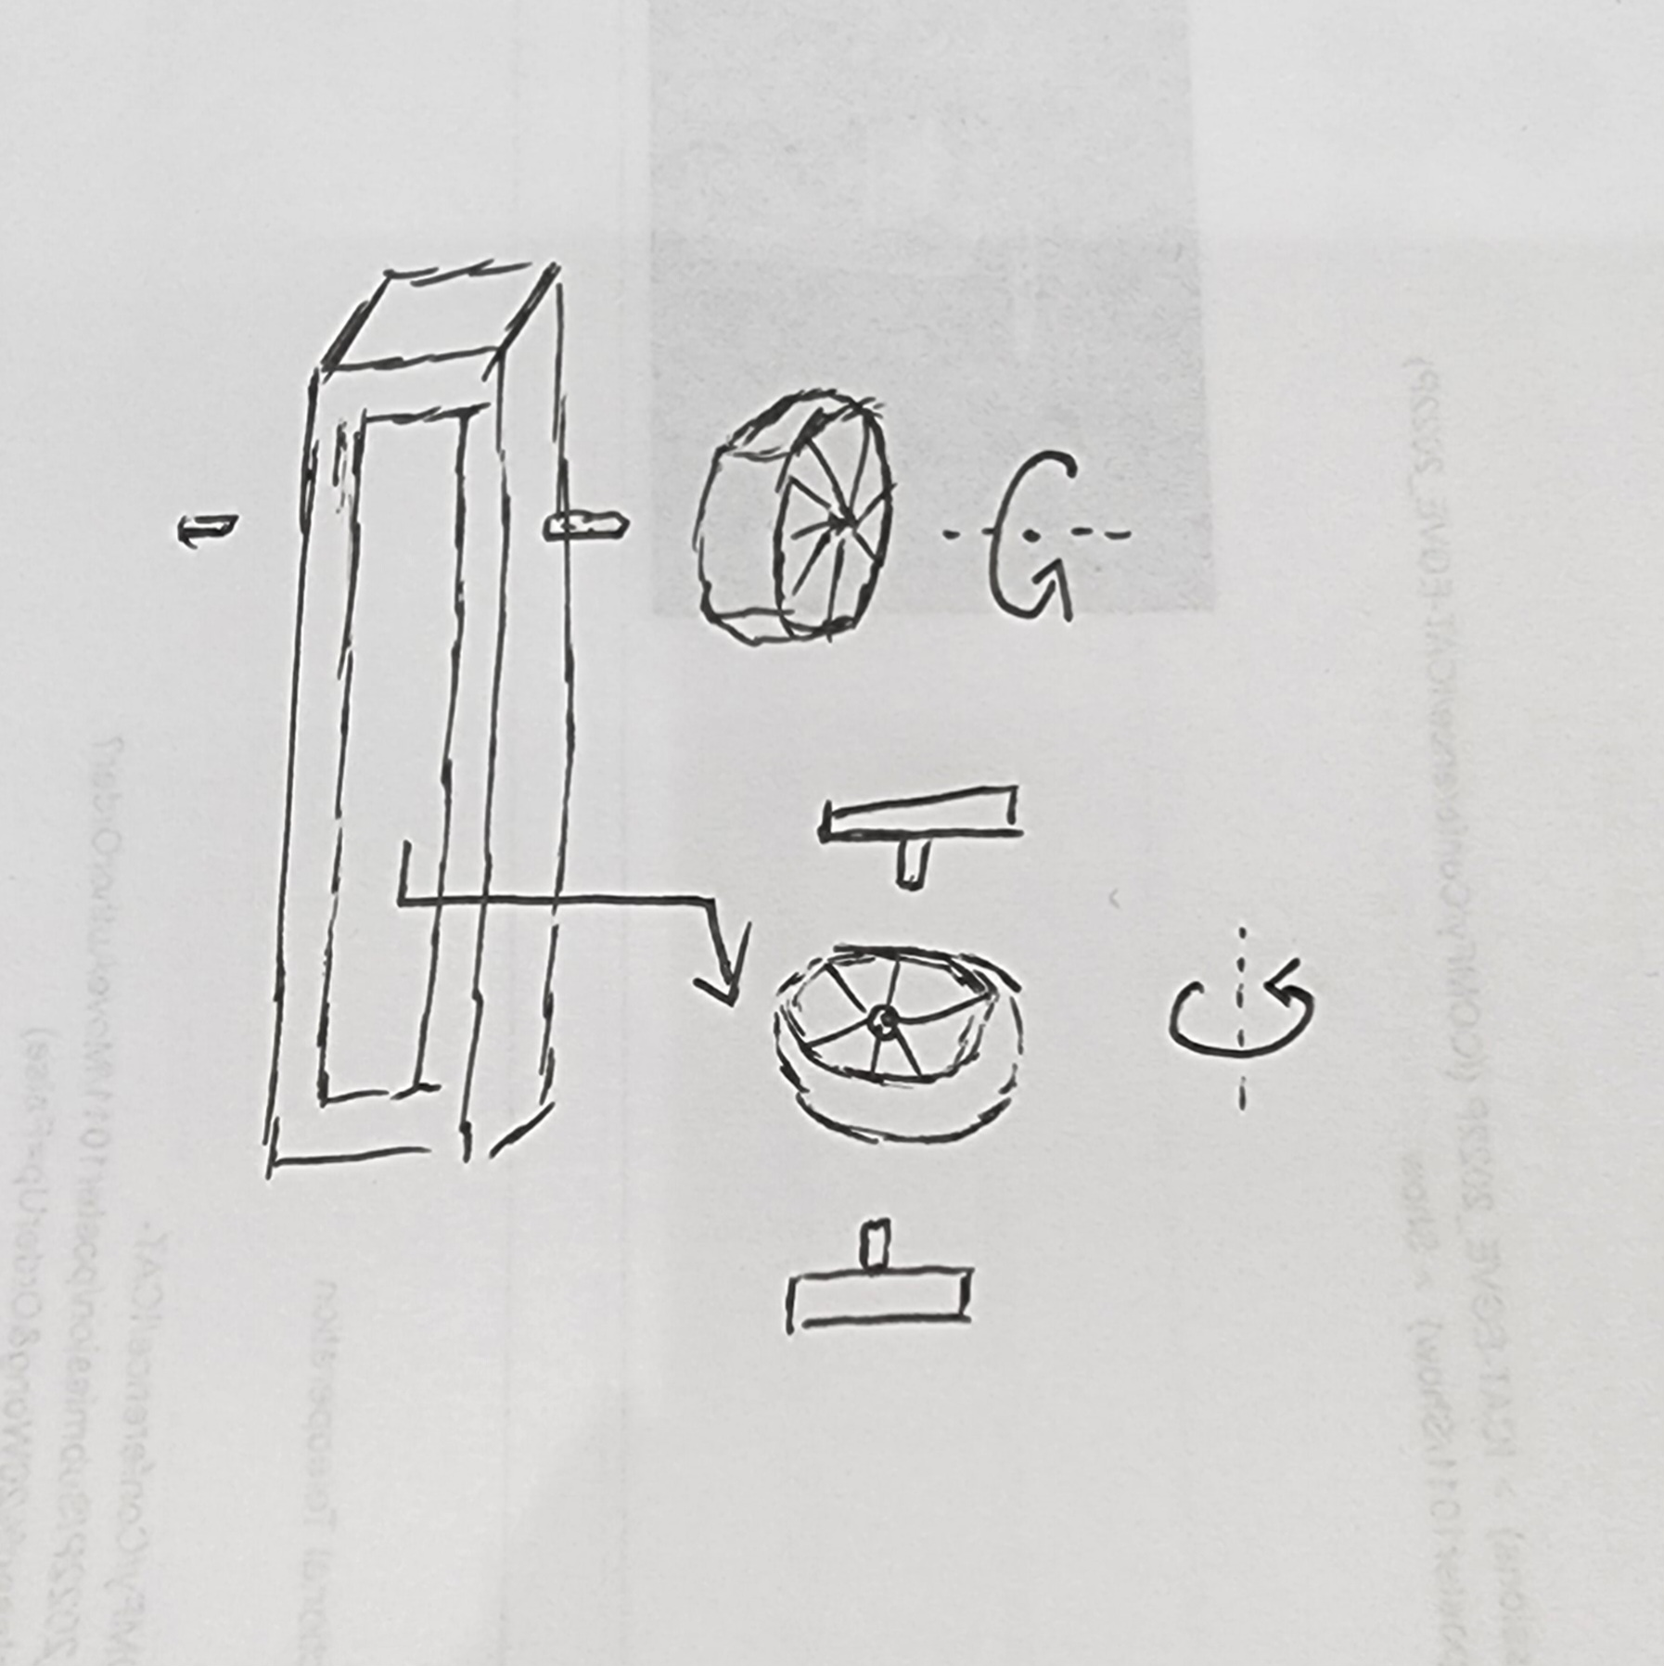
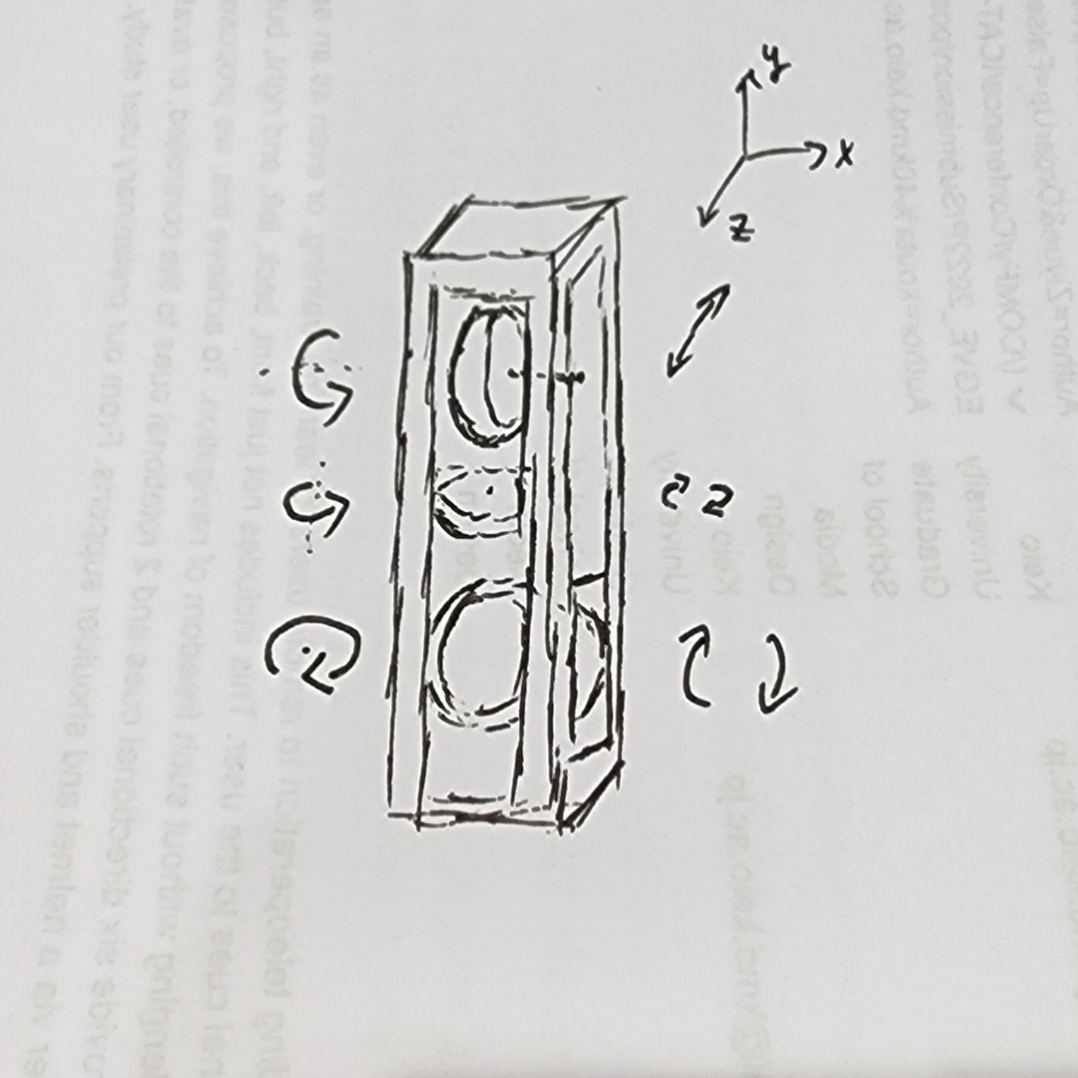
methods-1
Handheld controller, set some belt-winding wheel structure in the center part, and the user can feel the motion state of the object by touching these wheels by hand,the goal is to set 3 wheels to achieve 3dof feedback including front and back, left and right, up and down.
Notes:
design from seniror

Slide 13
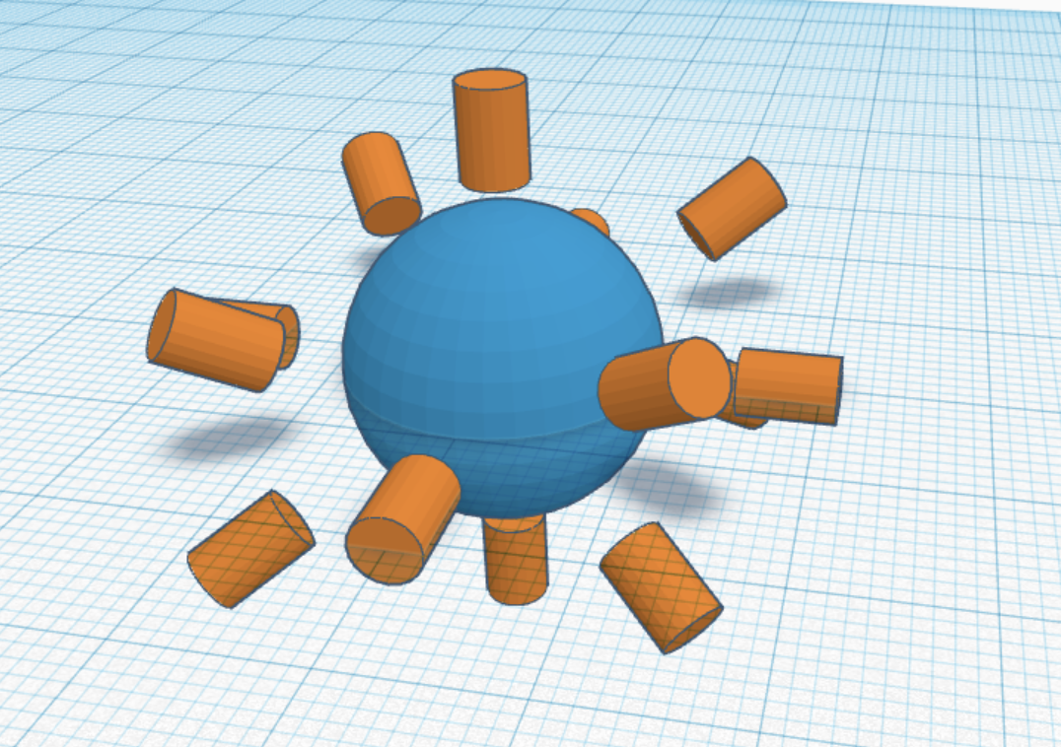
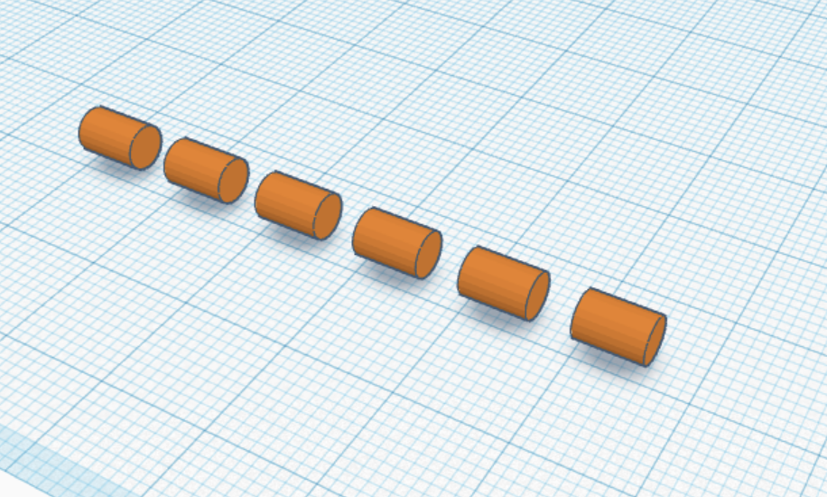
methods-2
A large number of haptic motor are used in superposition, and the full range of feedback or series structure can simulate the whole process of linear motion.

Slide 14
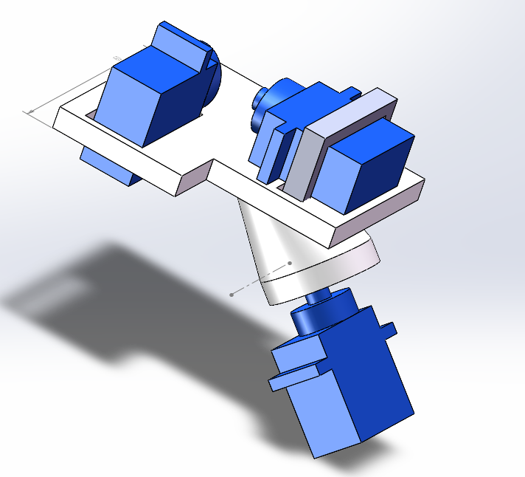
prototype

